Slide 1
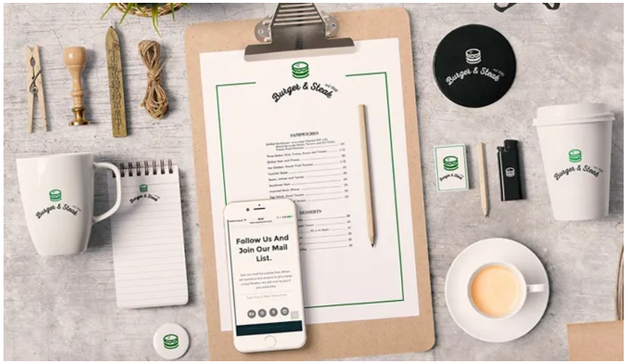
Mockup
Candela
Paula
Tino
Alejandro
Carles

